Slide 1
Predicting Online Shoppers Purchasing Intention
By:
Pavanika T
Vaishnavi B
Abhishek Reddy B
Jalender Reddy M

Slide 2
Agenda
Introduction
Problem statement
Objectives
Dataset description
Methodology
Analysis
Data preprocessing
Feature selection
Modeling
Support Vector, Passive Aggressive, & Random Forest Classifiers
Model Evaluation

Slide 3


Introduction
One of the most popular and rapidly expanding buying methods has been online shopping and evidenced in growing rapidly in customers who shop online and also increase in retail sales.
The huge boom in online sales have resulted in exponential growth in income for e-commerce platforms, a few are still facing growth stagnation despite the boom attributed to lack of market understanding.
Hence, the need to study online related data ‘online shopping intention’ to uncover hidden information helpful to struggling e-commerce platforms.
Problem Statement:
One of the main issue is customer fail to do transaction at very first time because of few factors which results in failing to attract customers towards online shopping.
So to know this we tried to explore features which attracts customers to buy and how are they manipulated to buy them. In addition to it we also tried to see what count of customers who visit show intentions to buy.

Slide 4
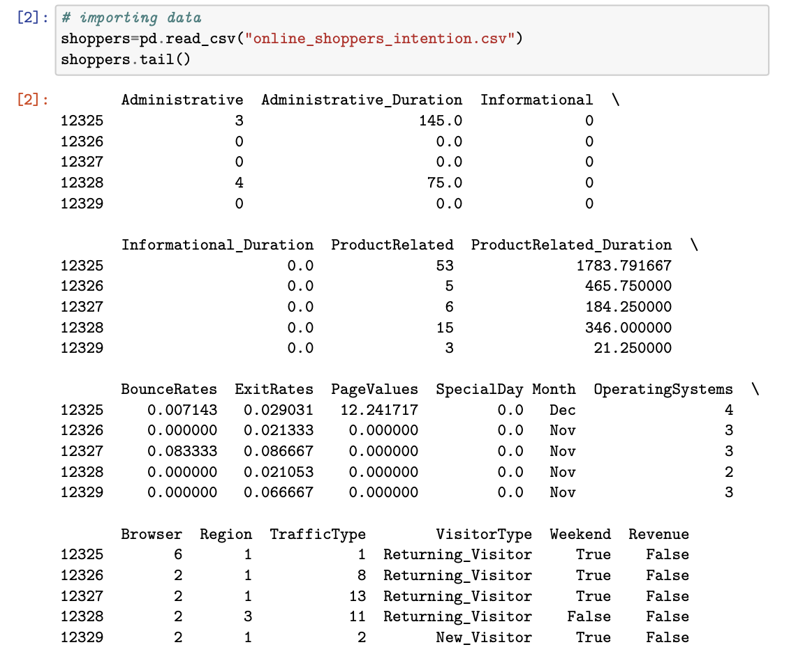
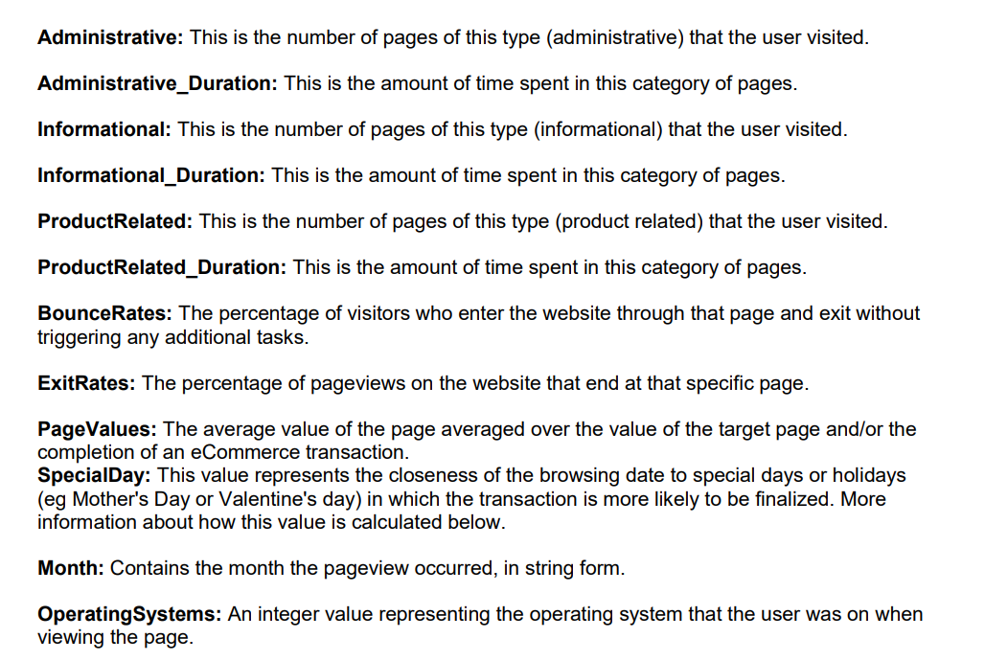
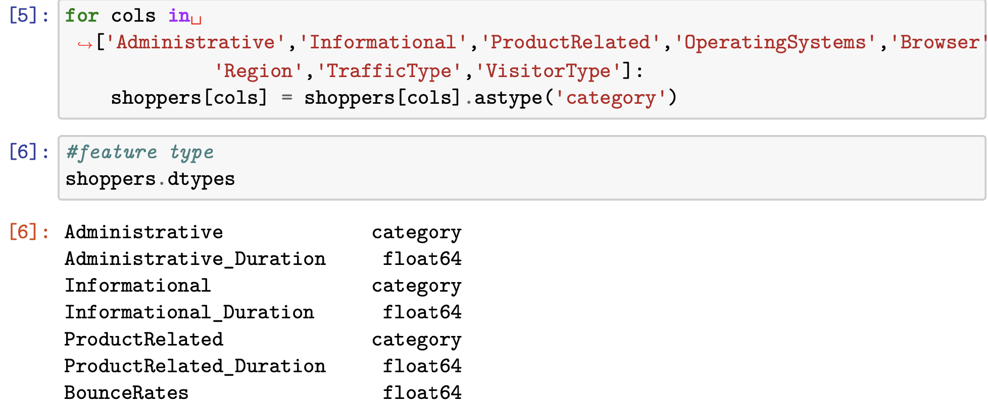
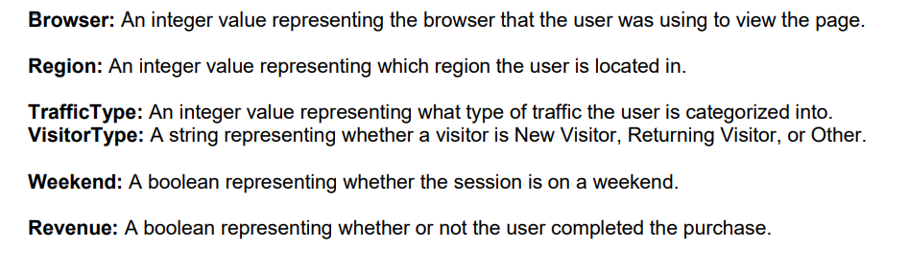
Data description

Slide 5
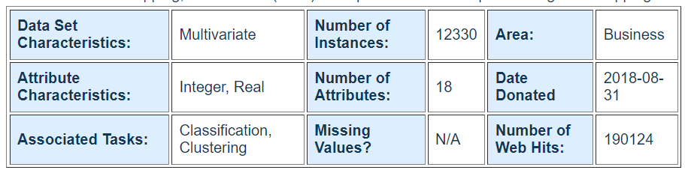
Objectives
Using machine learning techniques to:
Identify factors most influential to consumer purchasing intention.
Understanding the consumer purchasing behavior.
Developing a model for predicting the consumer intent to purchase
Test the hypothesis that revenue and pagevalues are independent of each other
Data description
Sourced from UCI machine learning repository link.
Has 18 features and 12330 observations (@ represent a visit)
Data span for 1 year
Has 8 categorical & 10 numeric features.

Slide 6
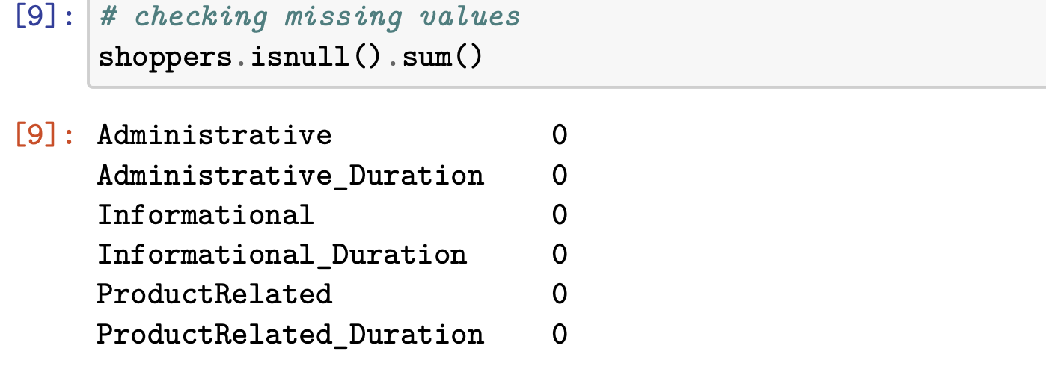
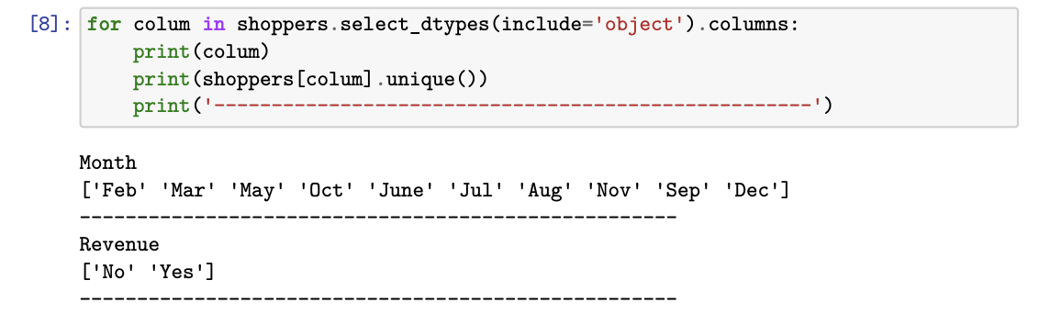
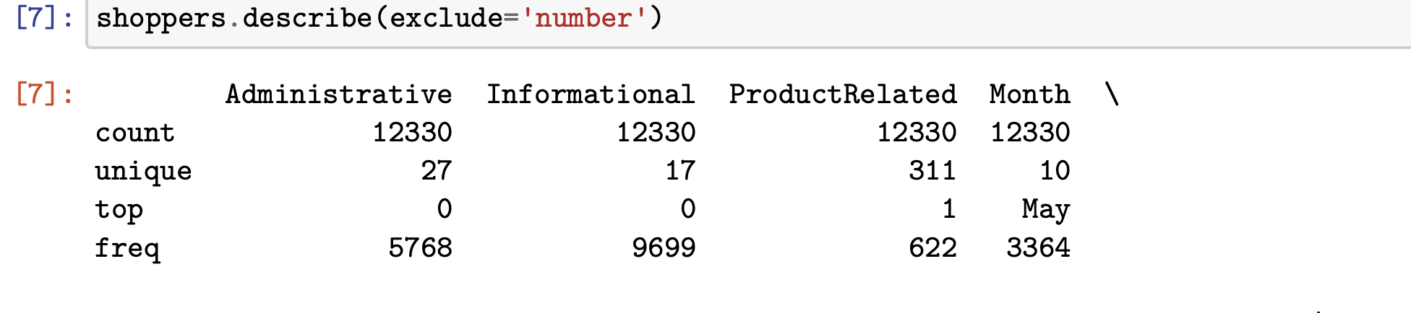
So here we are trying to check out for null values if present we try to remove them or make them non null values.
Describe() is used to show us the overview of the dataset.
Also trying to find the unique month with no duplicates.

Slide 7
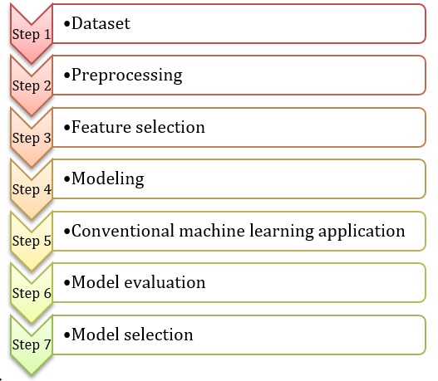
Methodology
Python for data science is used to investigate online shoppers purchasing intention dataset.
Essential steps:

Slide 8
Methodology cont.
The machine learning algorithms used are:
Support Vector classifier
Passive aggressive classifier
Random forest Classifier

Slide 9
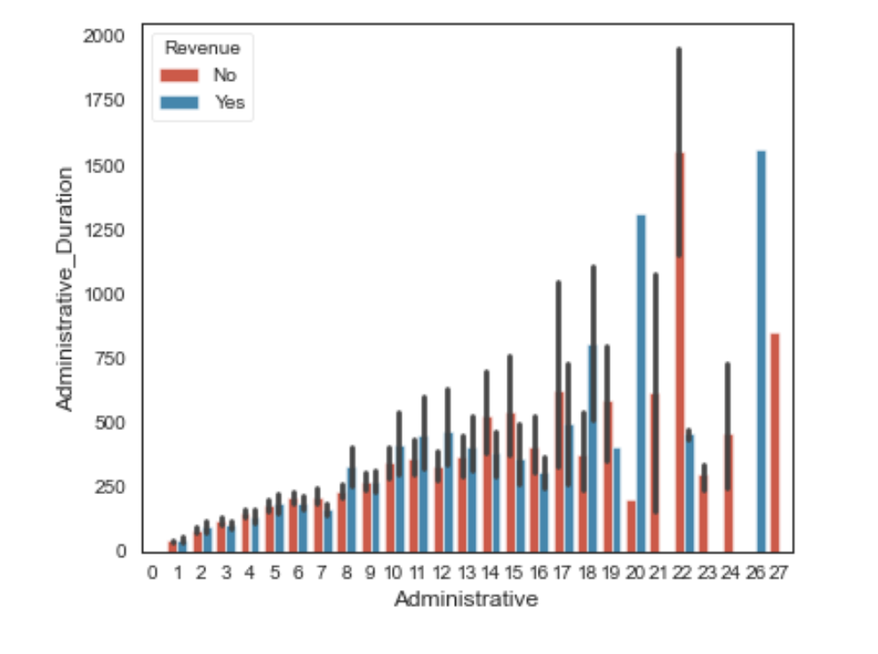
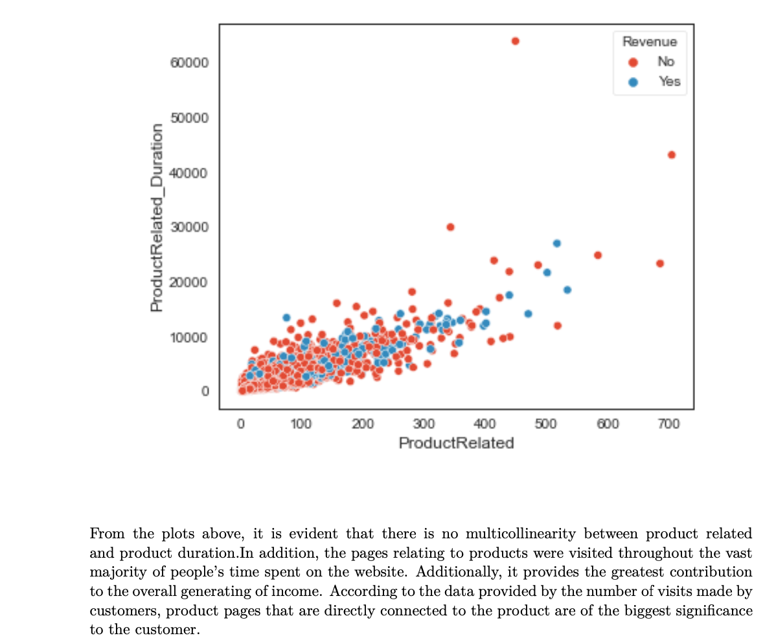
Analysis
Data preprocessing
There are no values that are missing from the dataset.
The hierarchy of the qualities was reorganized in accordance with the categorical and numerical bases, respectively.
In order to model the data, the categorical qualities were first organized into component variables, and then they were given a numerical encoding.
When clustering methods were used, the numerical variables in the dataset were scaled, and when classification methods were used, they were normalized.
During the training session, we utilized eighty percent of the data, and our models were validated using the remaining twenty percent of the data that had not previously been seen.

Slide 10
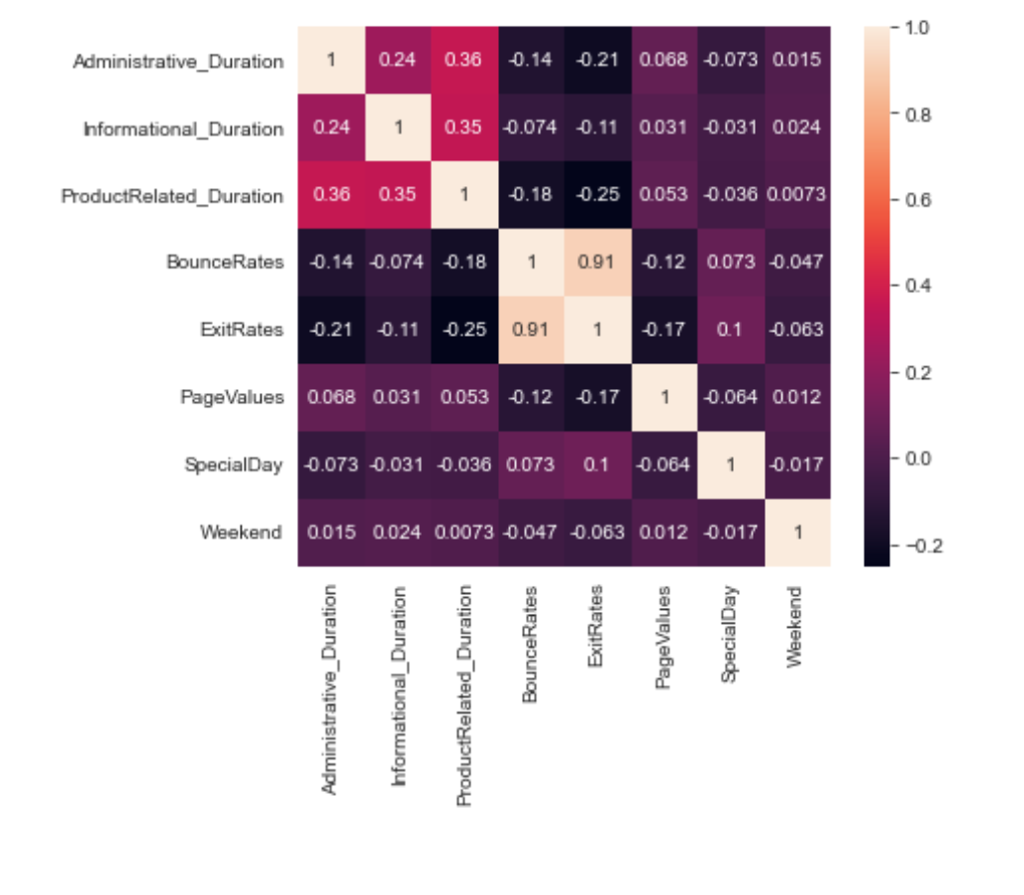
Analysis
Feature selection
The process will help with the identification of influential features to the model.
A simple random forest model is built with all necessary independent variables.
From the model, we determine the feature importance and rank them from the most to least important using ‘featurewiz’ module.
The we find the threshold of features that can help optimize the model
The selected features are split into training and testing data in 70:30 ratio.
There is a strong association between the values of each page and the amount of revenue made. Which is shown in the above correlational matrix.

Slide 11
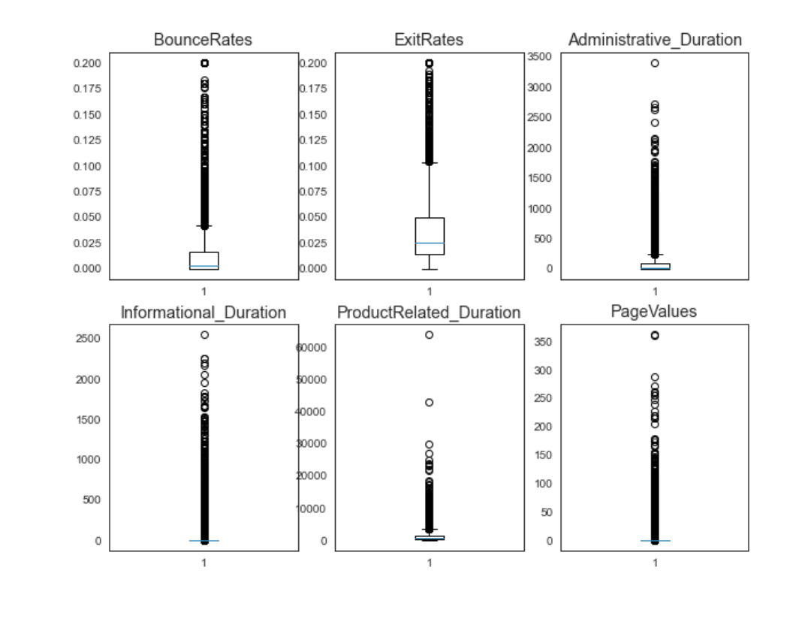
Analysis
Modeling
All models uses scikitlearn module (Hackeling, 2017).
SVM
Passive aggressive classifier
Implemented using scikitlearn library
Random classifier
Implemented from scikitlearn library
Default Hyper parameter values are used since it is not prone to overfitting
300 trees are chosen under n_estimator
It is patently obvious that there are a great deal of outliers. Informational duration and page values do not contain any outliers, and if you delete the values that are considered to be outliers, there will only be one value remaining in the set.

Slide 12
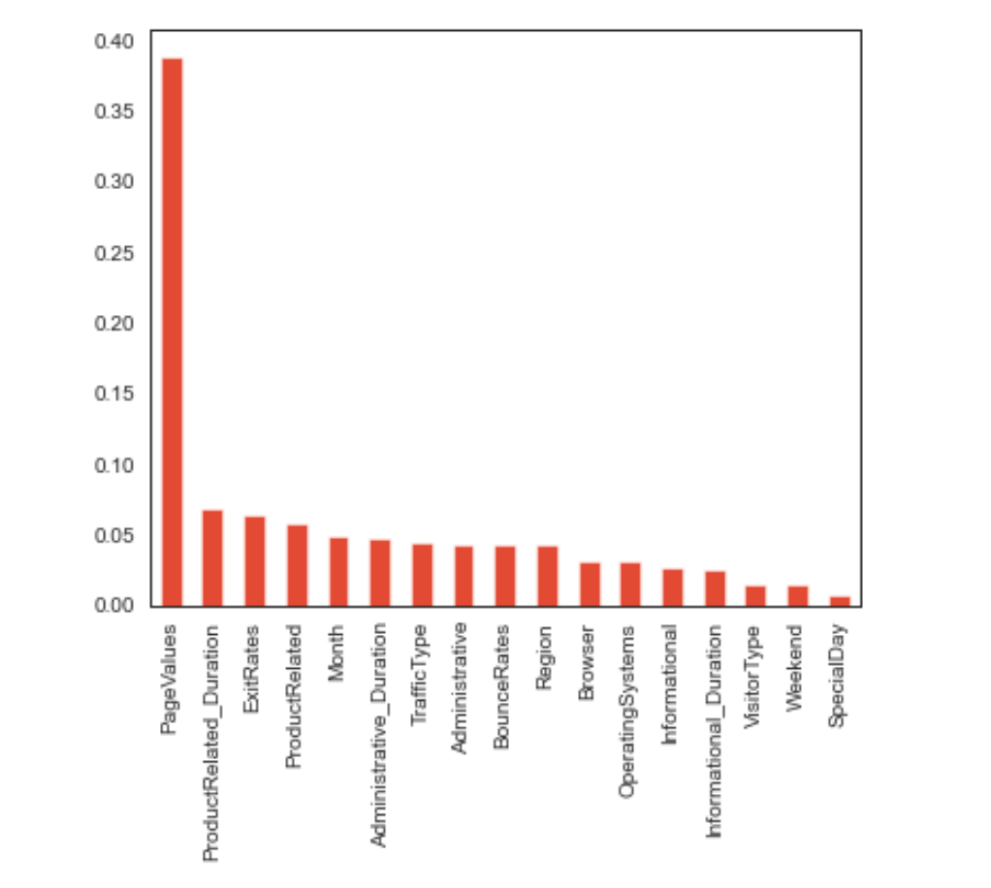
Analysis
Model evaluation
Models are evaluated using their accuracy and AIC value
The one with the highest accuracy is selected for further study and current application given we balanced the dataset.
Other metrics are based on confusion matrix.
The Visualization shows the feature importance.

Slide 13
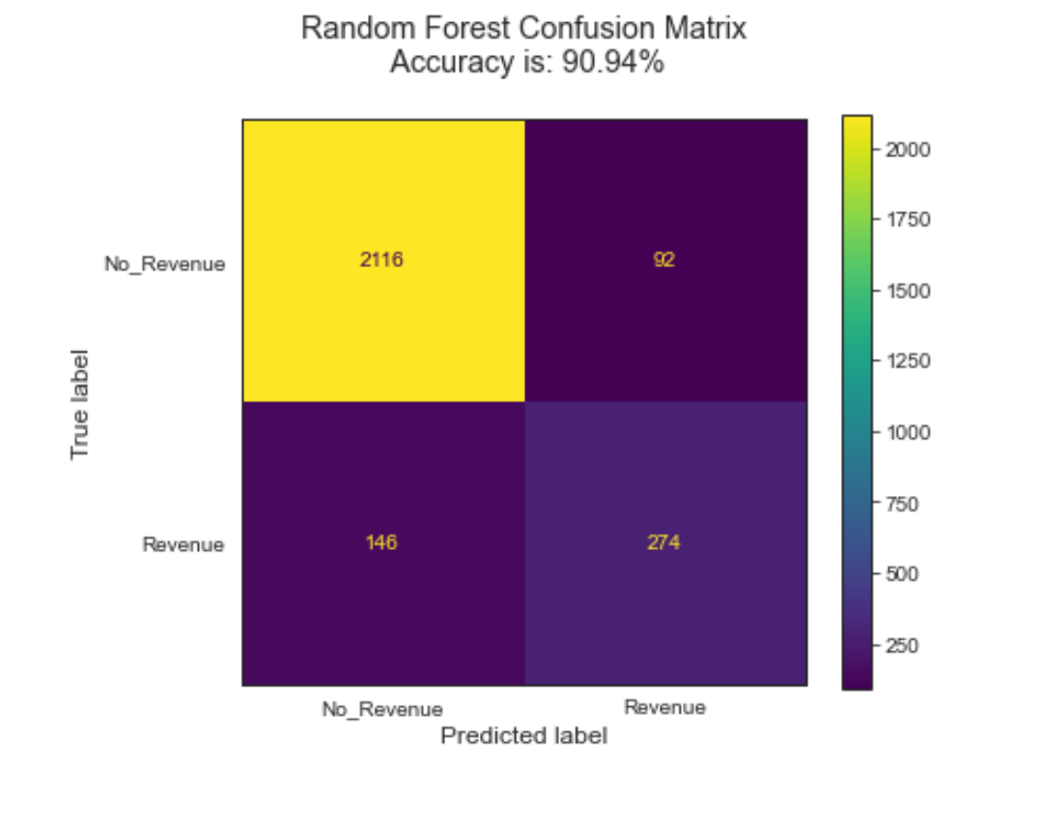
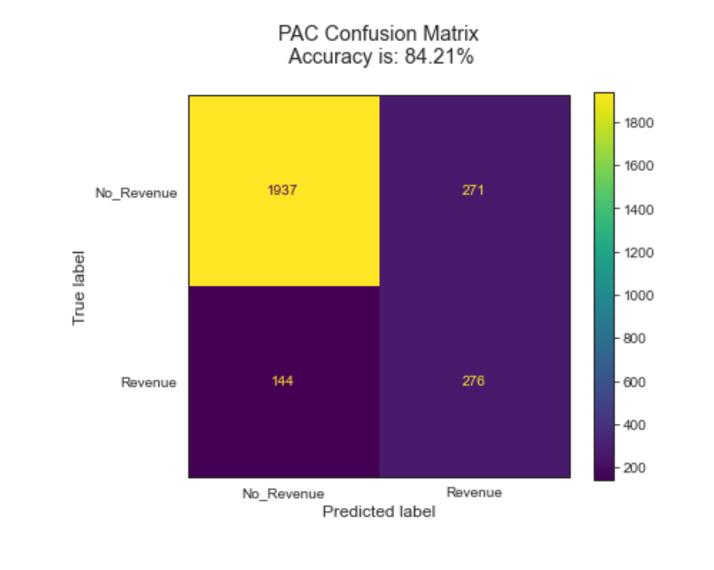
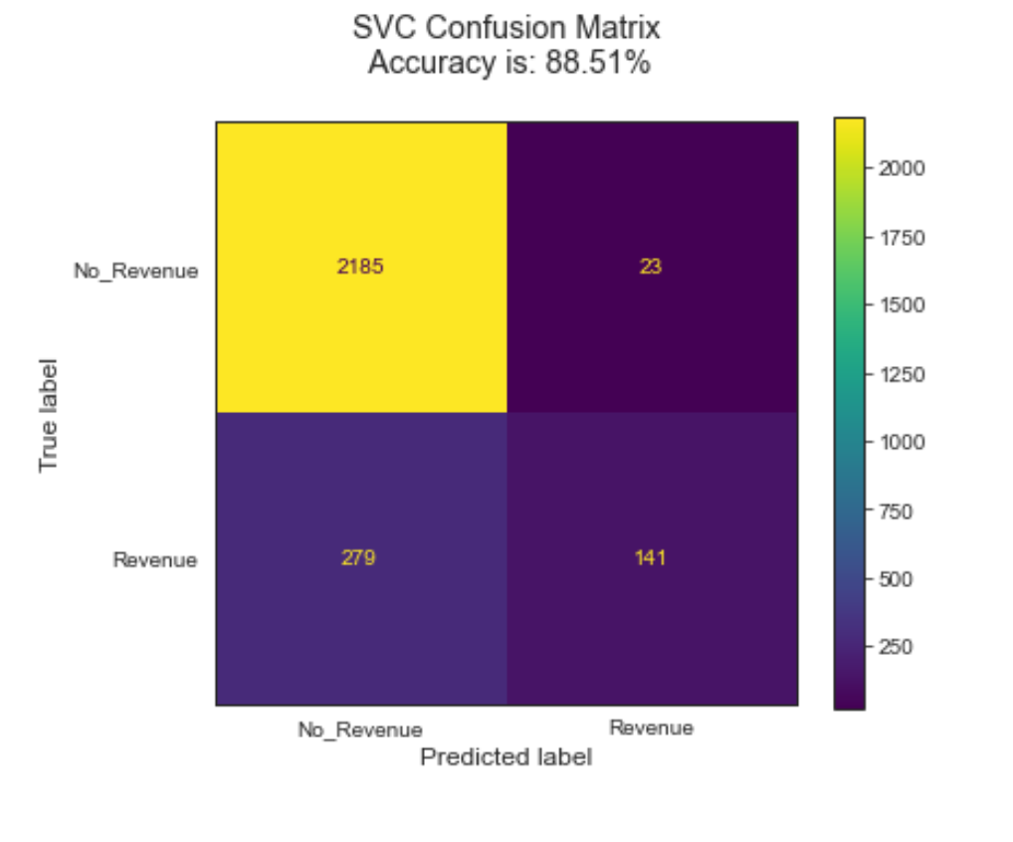
The different types of confusion matrices are shown to predict the data in different manners.
Random forest model outperforms the other models with an accuracy of 90.94%

Slide 14

Conclusion
In conclusion the primary goal centered on the discovery of important measures that contribute the most towards forecasting the behavior of a shopper, as well as the suggestion of prioritized vital suggestions and performance improvements on the same.
By using a random forest classifier, we are able to achieve approximately 90% accuracy. . If we were to deploy this model, the most efficient model to select would be our model.
The important criterion for determining whether or not a purchase was actually made is the revenue of the business.
Though the data is huge, it does not represent eCommerce globally rather constrained to its source.

Slide 15
References
Hackeling, G. (2017). Mastering Machine Learning with scikit-learn. Packt Publishing Ltd.

